Slide 1

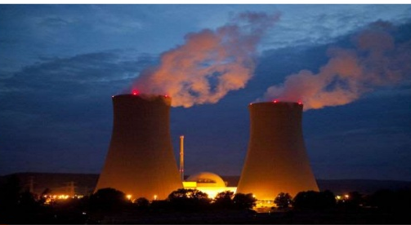
IDM Subject Code : CHM 2042
Nuclear
Disaster Management

Slide 2
NUCLEAR HAZARDS/ NUCLEAR POLLUTION

Slide 3
Topic to be discussed
Introduction
Sources of radio active pollution
Nuclear energy, fission and fusion process
Safety of Nuclear Plants
Types of radiation
Pathways Of Exposure to Human
Effects of Ionizing Radiation on living system
Some example of nuclear pollution and their consequences
Control measure to nuclear pollution
Conclusion

Slide 4
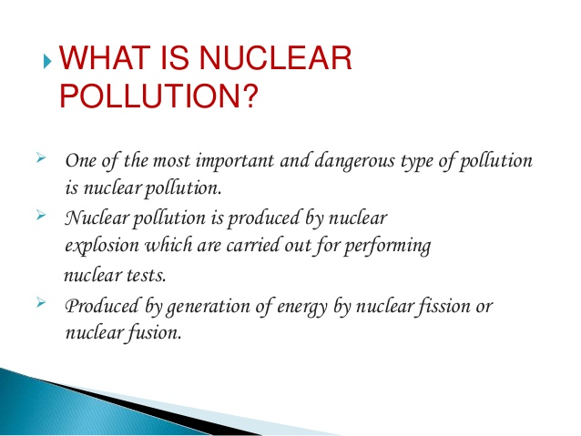
Radioactive Pollution
It is a invisible energy of wave (radiation) or particles pollute air and water; example alfa, beta, gama particle

Slide 5
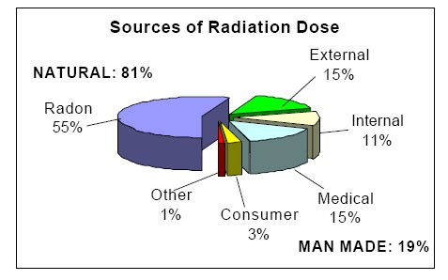
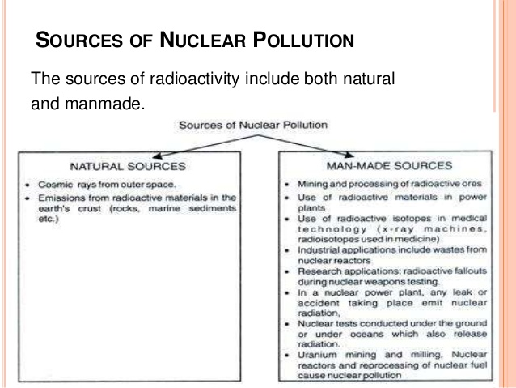
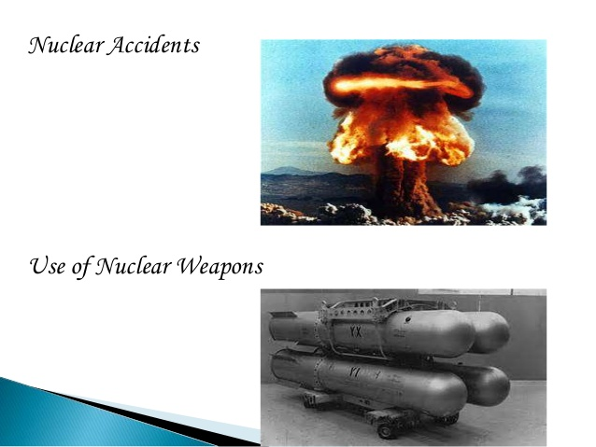
Sources of nuclear pollution
Natural sources (81%) include radon (55%), external (cosmic, terrestrial), and internal (K-40, C-14, etc.)
Man-made sources (19%) include medical (diagnostic x-rays- 11%, nuclear medicine- 4%),

Slide 6
Causes of Nuclear disaster
Nuclear power plant accidents
Nuclear reactor attacks
Trafficking and thefts
Worldwide nuclear weapon testing
Political issues like war, nuclear power aspirations,
fight between countries to become super power
Example: disaster events such as Hiroshima nuclear explosion, Syrian civil war, growing militarization of oceans and outer space.

Slide 7
Categories of nuclear accidents
Nuclear reactor meltdown
Criticality accidents
Decay heat
Transport
Equipment failure
Human error
Lost source

Slide 8
Nuclear disaster is due to meltdown of nuclear reactor plant and release of massive amount of radiation and radioactive materials into the environment . It is a type of explosion deriving its force from nuclear reactions- fission and fusion . It may be due to human error, system failure, earthquake, cyclone, flood etc.
Nuclear reactions

Slide 9
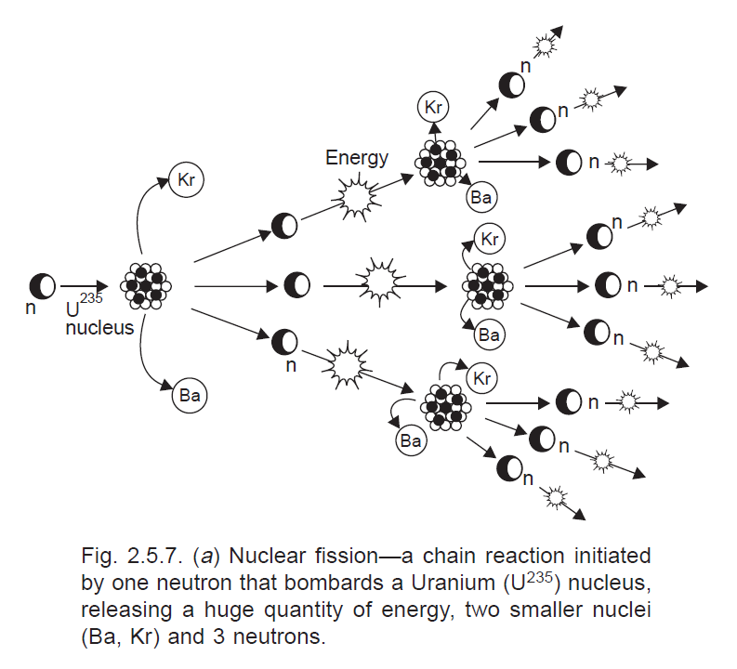
Nuclear energy
Nuclear Fission:
Nuclear energy is known for its high destructive power as evidenced from nuclear weapons.
Nuclear Fission: In this example, a stray neutron strikes an atom of U235. It absorbs the neutron and becomes an unstable atom of U-236. It then undergoes fission. These neutrons can strike other U-235 atoms to initiate their fission

Slide 10
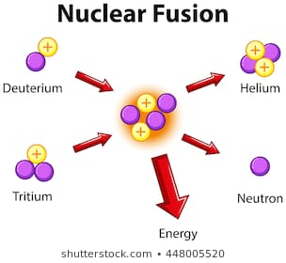
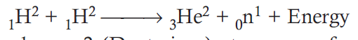
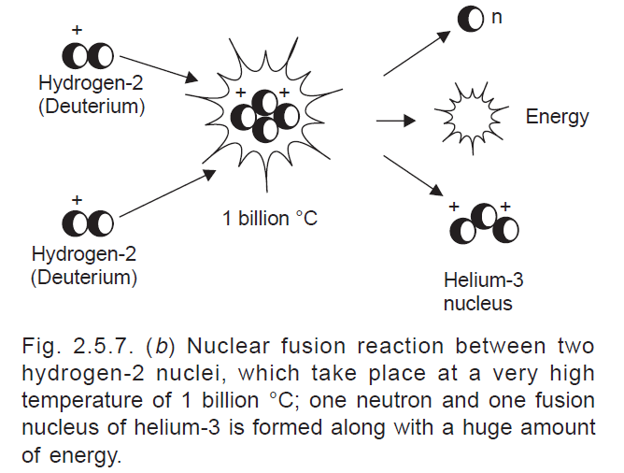
Nuclear fusion
(ii) Nuclear fusion: Here two isotopes of a light element are forced together at extremely high temperatures (1 billion °C) until they fuse to form a heavier nucleus releasing enormous energy in the process. 0.42Mev
One neutron and a huge amount of energy.
E = MC²
1.674927471×10⁻²⁷ X (3X10⁸)²
It is difficult to initiate the process but it releases more energy than nuclear fission.
There are four nuclear power stations with an installed capacity of 2005 MW.
These are located at Tarapur (Maharashtra), Rana Pratap Sagar near Kota (Rajasthan), Kalpakkam (Tamil Nadu) and Narora (U.P.).

Slide 11
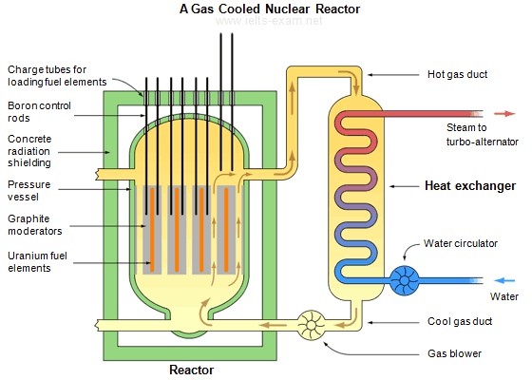
Nuclear reactor
If each neutron releases two more neutrons, then the number of fissions doubles each generation. In that case, in 10 generations there are 1,024 fissions and in 80 generations about 6 x 10 ²³ (a mole) fissions.
A nuclear reactor is a device in which nuclear chain reactions are initiated, controlled, and sustained at a steady rate,
Nuclear bomb, in which the chain reaction occurs in a fraction of a second and is uncontrolled causing an explosion.
Graphite: slow down the newtron and controller is to control the number of neutron
Boron: capable of absorbing many neutrons and control fission
Lead: molten lead or lead-bismuth eutectic coolant also absorb alfa, beta and gamma radiation

Slide 12
Nuclear reactor meltdown
Nuclear disasters are usually associated with reactor meltdowns.
A core meltdown accident occurs when the heat generated by a nuclear reactor exceeds the heat removed by the cooling systems
If the core continues to heat, the steel wall of the core would melt.
In a complete reactor meltdown, the temperature may exceed 2700⁰ C

Slide 13
Safety of Nuclear Plants
Steel-reinforced concrete and a dome-shaped containment buildings surround all US reactors (inner wall several feet thick and outer wall at least 15 inches thick)
Designed to withstand hurricanes, earthquakes, high winds
Reactors have detectors to quickly shut down in event of tremor (about 20% are in regions with seismic activity like Pacific Rim)
In considering safety, must address…
Faults in plant design
Human error
Risks associated with terrorism/political instability

Slide 14
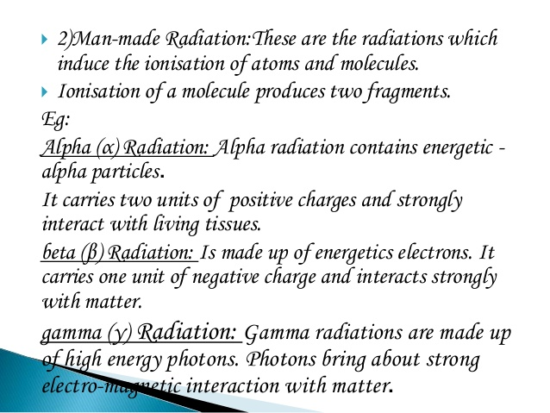
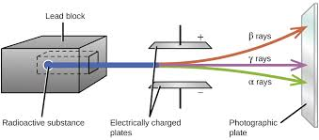
Types of Radiation

Slide 15
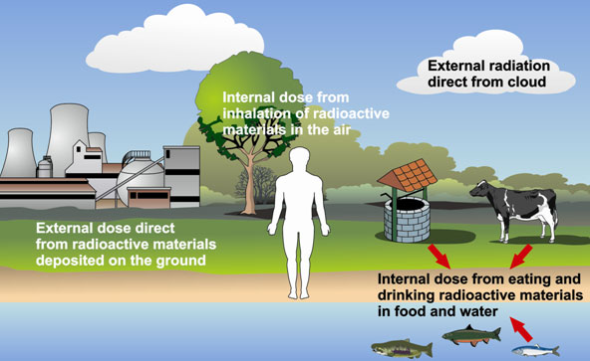
Pathways Of Exposure to Human

Slide 16
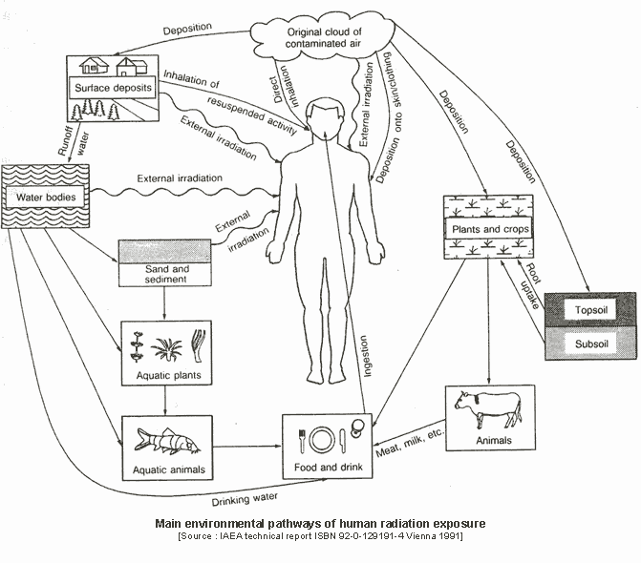
Pathway of Human radiation exposure

Slide 17
Effects of Ionizing Radiation on living system
Ionizing radiation has sufficient energy to knock bound elections out of an atom or molecule
Includes alpha/beta particles and gamma/x-rays
Can form highly reactive free radicals with unpaired electrons
For example, H₂O → [H₂O.] + e⁻
Rapidly dividing cells in the human body are particularly susceptible to damage by free radicals
Radiation can be used to treat certain cancers and Graves disease of the thyroid
However, ionizing radiation can also damage healthy cells
Biological damage determined by radiation dose, type of radiation, rate of delivery, and type of tissue

Slide 18
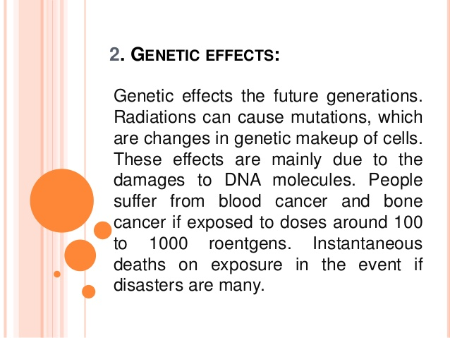
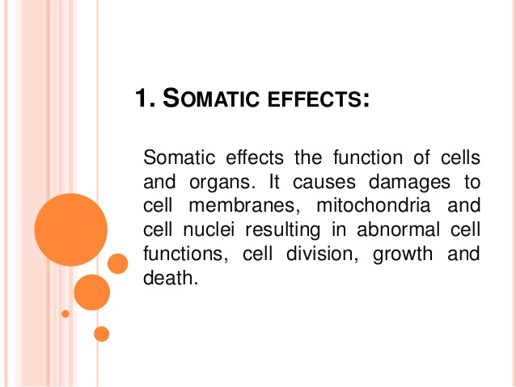
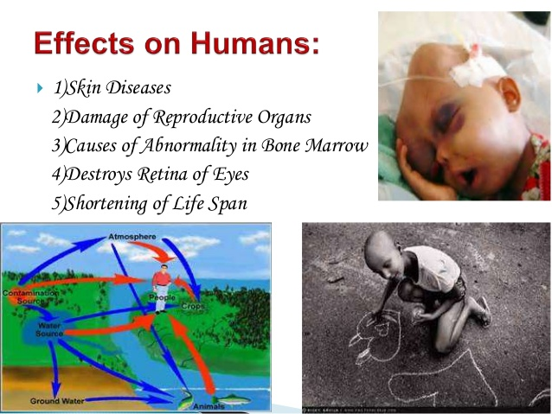
Effects of nuclear pollution on animals
Radiation effects can be somatic or genetic.

Slide 19
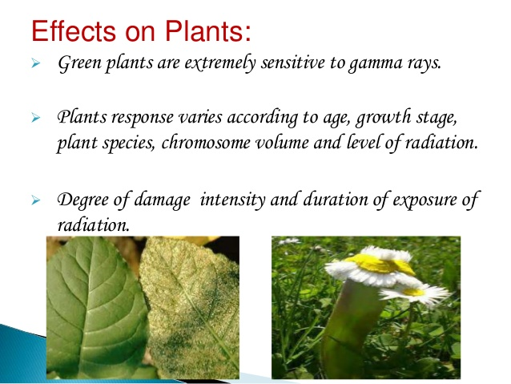
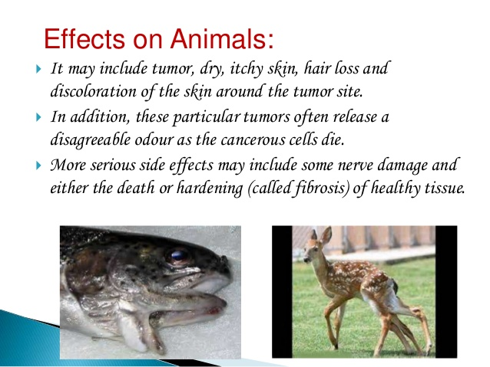
Effects on Plants

Slide 20
SOME LIVE EXAMPLES
OF
“NUCLEAR POLLUTION”

Slide 21
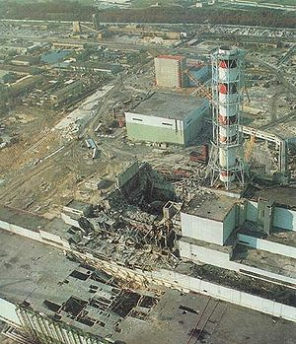
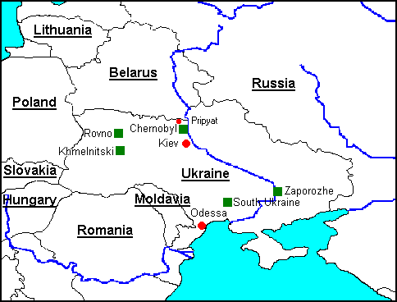
Chernobyl Accident- April 26, 1986
World’s worst nuclear power plant accident
Chernobyl in Ukraine on Pripyat River
Combination of design and operator error during electrical power safety check resulted in cascade of events leading to core breach of Reactor 4 with subsequent chemical (not nuclear) explosion

Slide 22
Chernobyl Accident
Flow of coolant water interrupted, insufficient
Graphite used to slow neutrons in reactor caught fire. Water sprayed on graphite, resulting in hydrogen gas formation- chemical combustion reaction and explosion
2H₂O(l) + C(graphite) → 2 H₂(g) + CO₂(g)
2H₂(g) + O₂(g) → 2H₂O(g)
Large amount of radioactive fission products dispersed into atmosphere for 10 days (about 100X greater than Hiroshima/Nagasaki)
150,000 people in 60 km radius permanently evacuated
several workers immediately, about 30 firefighters/emergency workers from acute radiation exposure, and a smaller # from subacute effects (overall, about 60 deaths)
About 250 million people exposed to radiation levels which may reduce lifespan

Slide 23
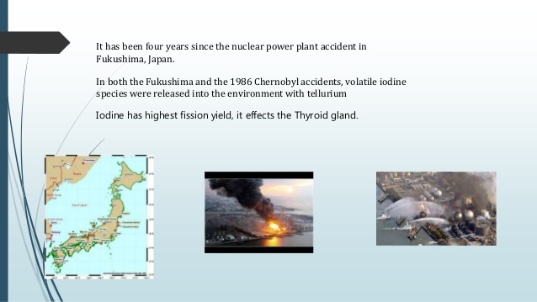
Chernobyl Accident
Surrounding farmland (1000 square miles) not farmable due to high Cs-137 (exception, one small area in Belarus)
High levels of Cs-137 found down wind in reindeer meat in Scandinavia
Contamination effects on plants/animals within 30 km
Contamination of nearby water bodies and fish

Slide 24
Chernobyl Accident
Initial radiation released primarily I-131 (half life= 8 days), later Cs-137 (half life= 30 years)
Children particularly susceptible to I-131. Thyroid takes up I⁻ to produce the hormone thyroxine (T4, growth/metabolism).
I-131 decays by beta emission with accompanying gamma ray
If ingested, can cause thyroid cancer
About 4000 cases of thyroid cancer in exposed children (2000), nine related deaths in this group
http://www.world-nuclear.org/info/chernobyl/inf07.htm

Slide 25
Chernobyl Accident
Preliminary evidence (2006) suggests increased risk of leukemia and possibly other cancers in “liquidator” group and others with higher exposure in the first year- “Among some 600,000 workers exposed in the first year, the possible increase in cancer deaths due to this radiation exposure might be up to a few percent.”
Surrounding farmland (1000 square miles) not farmable due to high Cs-137 (exception, one small area in Belarus)
High levels of Cs-137 found down wind in reindeer meat in Scandinavia
Contamination effects on plants/animals within 30 km
Contamination of nearby water bodies and fish
http://www.world-nuclear.org/info/chernobyl/inf07.htm

Slide 26
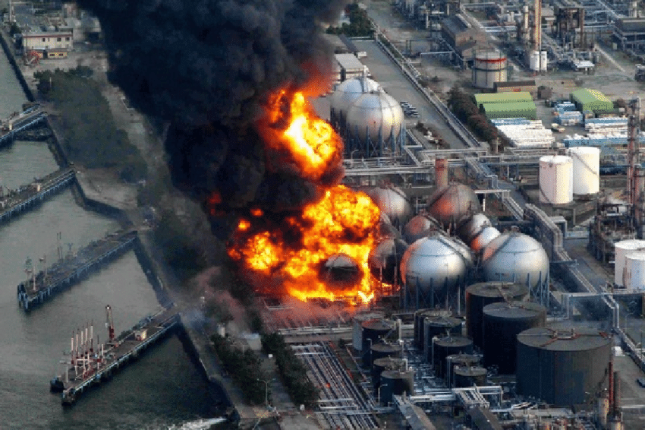
The Fukushima Daichi Disaster

Slide 27
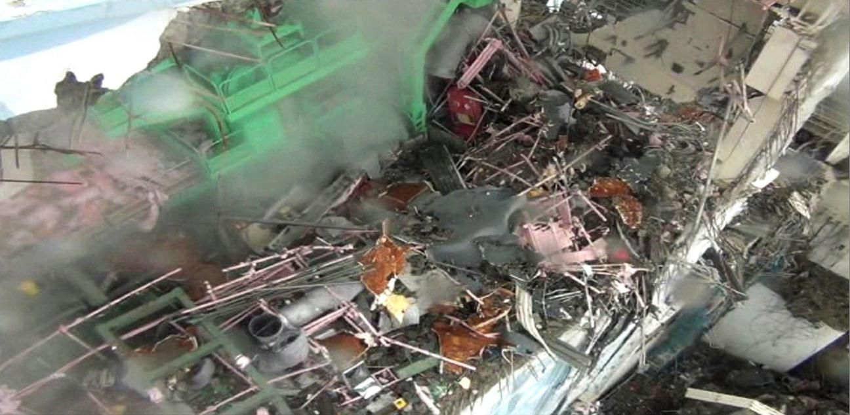
The aftermath

Slide 28
The Fukushima Disaster
On March 11th 2011 a huge earthquake
caused the cooling of the reactors and the cooling of the spent fuel pools of the Fukushima Daiichi nuclear plants to fail.
A non-stoppable nuclear disaster unveiled.
The release of radioactive material occurred through pressure relief, uncontrolled release of radioactive steam, fires, explosions and leakage and seepage of hundreds of thousands of litres of contaminated water.
Contrary to the Chernobyl disaster (1986) this disaster happened in multiple reactors at once – and it is still ongoing.

Slide 29
Release and dissemination for radioactive materials
first six weeks of the disaster 42% of the total amount of cesium that was released.
After the explosions also radioactive strontium (up to 250 kilometres from the plants) and plutonium (up to 45 kilometres from the plants) are measured, in addition to iodine and caesium.
Particularly high levels of radiation are measured in the soil outside the 30-km (evacuation) zone. Large parts of Japan are contaminated for at least 300 years) with cesium, mainly in the northeast.
Around 164,000 people were evacuated from the area around the damaged reactors
workers nearly 2000 were found to be contaminated with a radiation dose above 100 mSv – a dose which causes radiation related diseases. Six workers were contaminated with doses from 309 mSv to 678 mSv.

Slide 30
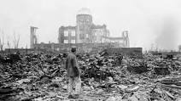
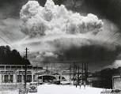
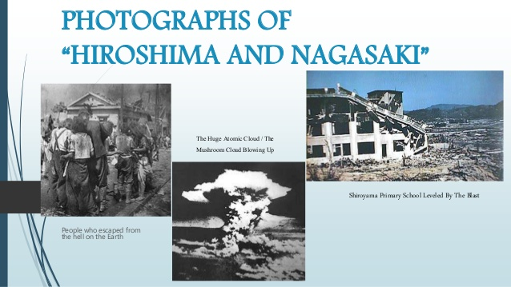
Photograph of Hiroshima and Nagasaki

Slide 31
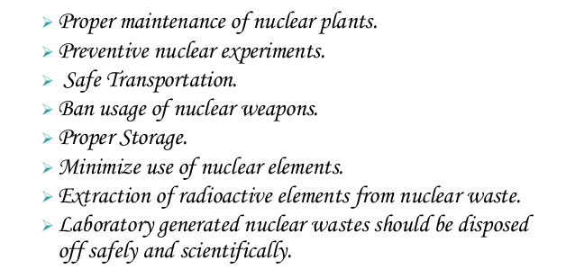
Control and Measures

Slide 32
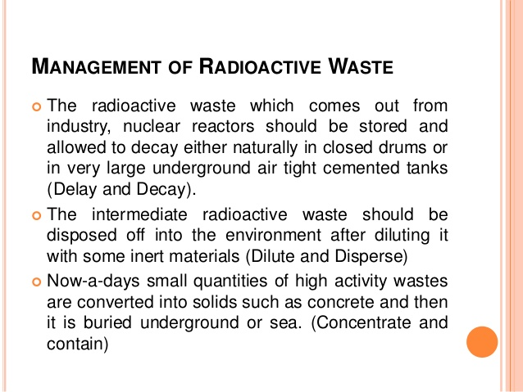
Management of Radioactive Waste

Slide 33
Nuclear disaster mitigation measures
Stabilize the electricity supply system
Store spent fuel in dry casks
Install filtered vent systems
Nuclear reactors must be enclosed in broad concrete walls to prevent the radiation from emerging out
Workers should wear protective garments and glass spectacles
Extreme care should be exercised in the disposal of industrial waste contaminated with radionuclides
Prevent sabotage at nuclear facilities
Ratify a treaty to prohibit military attacks

Slide 34
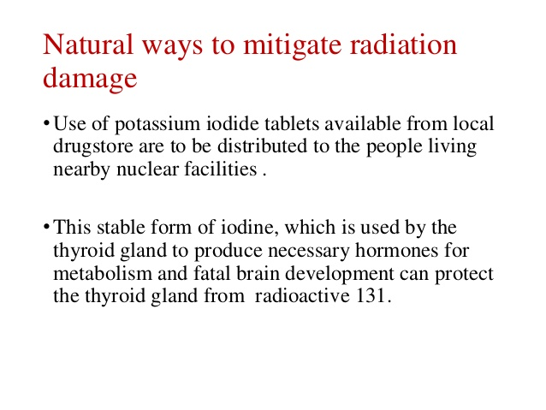
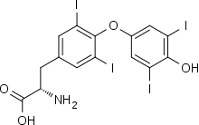
KI (potassium iodide) is a salt of stable (not radioactive) iodine that can help block radioactive iodine from being absorbed by the thyroid gland, thus protecting this gland from radiation injury.

Slide 35
Responses (Instructions issued by Department of Atomic Energy,) Govt. of India
Dos:
Go indoors. Stay inside. Close doors/windows
Switch on radio/TV and look out for public announcement from your local authority
Cover all food, water and consume only such covered items
If in the open, cover your face and body with a wet handkerchief/towel. Return home. Have a complete wash and use fresh clothing
Extend full cooperation with local authorities and obey their instructions.

Slide 36
Don’ts:
Do not panic
Do not spread and/or believe in rumours
Do not go outside
Avoid water from open well/ponds, exposed crops and vegetables
Do not disobey any instruction of the district or civil defence authority who are working tirelessly to ensure safety of yourself, your family and property.

Slide 37
Action taken during or immediately after disaster (Crisis management)
Evacuation, search and rescue, saving lives and identification of dead
Meeting basic needs of the survivor, ie. Shelter, hospitalization, food and water, personal hygiene, sanitation etc.
Activating public warning systems
Rehabilitation and reconstruction of damaged infrastructure

Slide 38
Post disaster recovery plans
Resilience after a nuclear power plant or other radiation emergency requires response and recovery activities that are appropriately safe, timely, effective, and well organized.
Use of high-level scientific, medical, communication, and policy expertise
Health and medical issues are given the central role.
Restoration of physical, environmental, economic and social stability
Removal and disposal of contaminated material in sealed underwater cask before transporting the containers to a storage building.

Slide 39
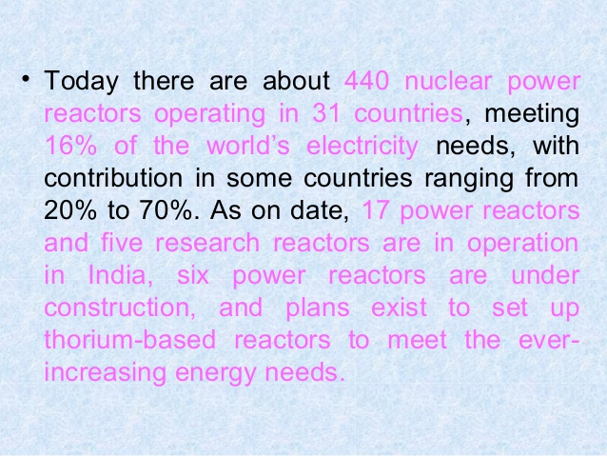

Slide 40
International Day for the Total Elimination of Nuclear Weapons: 5 worst nuclear disasters
Nuclear weapons have destroyed more than any other man-made disaster. The International Day for the Total Elimination of Nuclear Weapons is celebrated every year on September 26 to bring to attention what disasters nuclear weapons are capable of.
Most of us only know of the nuclear bombings at Hiroshima and Nagasaki during World War II and the devastating humanitarian consequences of the use of nuclear weapons.

Slide 41
Let us know about the five worst nuclear disasters in the history of mankind:
1. Hiroshima and Nagasaki:
Two nuclear weapons have been exploded by the United States during the World War II, 1945.
The first event occurred on the morning of August 6, 1945, on the Japanese city of Hiroshima.
The second event occurred three days later on the city of Nagasaki.

Slide 42
2. Chernobyl:
The worst nuclear accident in history, that occurred on April 26, 1986 at the Chernobyl Nuclear Power Plant in Ukraine.
3. Fukushima:
The nuclear disaster at the Fukushima Nuclear Power Plant began on March 11, 2011 and resulted in a meltdown of three of the plant's six nuclear reactors.
4. Three Mile Island:
The Three Mile Island accident was a partial nuclear meltdown that occurred on March 28, 1979 in one of the two Three Mile Island nuclear reactors in Dauphin County, Pennsylvania, United States.

Slide 43
The first Nuclear test in India
Smiling Buddha (Pokhran-I) was the assigned code name of India's first successful nuclear bomb test on 18 May 1974. The bomb was detonated on the army base Pokhran Test Range (PTR), in Rajasthan, by the Indian Army under the supervision of several key Indian generals.

Slide 44
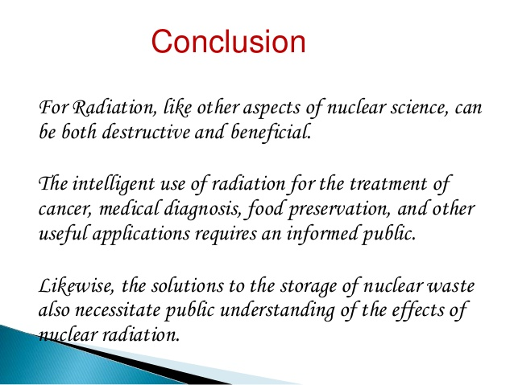
Conclusion

Slide 45

Prepared by; Dr Naresh Kumar Sahoo

